Slide 1





S1000D:
The data behind the BBMF Viewer

Slide 2

ASD S1000D Overview
        What is S1000D?
        The Data Module
        The Publication Module
        Simplified Technical English (STE)
Notes:
This presentation is designed to explain what S1000D is and how it is used on the BBMF maintenance documentation.
The areas covered include:
What is S1000D and how does it affect how we use the documentation
An explanation of the S1000D Data Module and what information it offers
An explanation of the S1000D Publication Module and how it is used
An explanation of Simplified Technical English, or STE, and how it affects the data you read when carrying out a procedure

Slide 3
What is S1000D
S1000D is a specification for technical publications.
S1000D is stored as chunks of information called Data Modules.
S1000D data is stored in a Common Source DataBase.
Data Modules define individual topics, or tasks.
S1000D uses the concept of re-use.
S1000D data is used to create the BBMF viewer, or IETP.
Notes:
S1000D is an international specification that gives rules and guidance for the production of technical publications.
S1000D publications are created using XML. The data is stored as chunks of information called Data Modules.
S1000D data is stored in a particular type of content management system called a CSDB, or a Common Source Database.
Data Modules define individual topics, or tasks, for example, a single maintenance procedure or description of a part, or activity.
This specification is predicated on the concept of “write once, use many times”, using Data Modules which can be reused and/or repurposed in one or many publications.
The maintenance data created for the BBMF platforms is created using S1000D and is delivered as S1000D publications called IETPs, or Interactive Electronic Technical Publications.

Slide 4
The Data Module
What is a Data Module?
  A DM is self-contained topic or procedure
  Contains text and references to graphics and other DMs
How is a Data Module used?
  DMs are designed for reuse
Notes:
A data module is the basic information unit for an S1000D document.
Each one contains a particular topic or procedure related to the equipment.
Data modules contain text as well as references to illustrations, multimedia objects, or links to other data that is related to that text.
The illustrations and multimedia objects are not stored directly in the data module, but rather referenced to further facilitate reuse.
Each data module in a CSDB project is unique.
Where data is common to multiple programmes or publications a data module can be created to be reused as many times as necessary.
This reusable data module must be a completely self-contained set of information, for example, a complete repair procedure.
A goal of S1000D is to permit data modules to be used by other projects and even other services since a data module may be appropriate for more than one programme.

Slide 5
The Data Module Code
Each Data Module has a unique identifier: a DMC.
The Raytheon Eagle CSDB manages the DMCs.
DMCs can be seen in the LiveContent IETP in the TOC or as links.
The DMC enables chunks of information to be managed or reused.
The illustrations or multimedia objects have a similar code, the ICN.
The DMC’s structure is standardised.
Notes:
Each Data Module has a unique identifier, known as the Data Module Code, or DMC for short.
The Raytheon Eagle Common Source DataBase, or CSDB, manages the DMCs.
The DMC can be seen in the LiveContent IETP in the table of contents or as links from one Data module to another
The DMC, together with other metadata, allows Data Modules to be independently managed and reused.
The illustrations or multimedia objects associated with the data modules have a similar code known as the Illustration Control Number, or ICN.
The DMC’s structure is standardised, even though the lengths of its individual components may vary. The DMC can range from 17 to 41 alphanumeric characters.

Slide 6
Data Module Code (cont’d)
 | DMC | SPITFIRE-AAAA-29-10-04-00AA-520A-A
 | Model Identification | SPITFIRE-AAAA-29-10-04-00AA-520A-A
 | System Difference Code | SPITFIRE-AAAA-29-10-04-00AA-520A-A
SNS | System | SPITFIRE-AAAA-29-10-04-00AA-520A-A
 | Subsystem | SPITFIRE-AAAA-29-10-04-00AA-520A-A
 | Sub Subsystem | SPITFIRE-AAAA-29-10-04-00AA-520A-A
 | Unit or Assembly | SPITFIRE-AAAA-29-10-04-00AA-520A-A
 | Dissassembly Code | SPITFIRE-AAAA-29-10-04-00AA-520A-A
 | Dissassembly Code Variant | SPITFIRE-AAAA-29-10-04-00AA-520A-A
 | Information Code | SPITFIRE-AAAA-29-10-04-00AA-520A-A
 | Information Code Variant | SPITFIRE-AAAA-29-10-04-00AA-520A-A
 | Item Location Code | SPITFIRE-AAAA-29-10-04-00AA-520A-A
Notes:
This is an example of a Data Module Code.
You can see the breakdown of the code starting with the Model identification which for this project is SPITFIRE.
The system difference code will always be the same for these projects.
The DMC then continues with breakdown information from the aircraft-specific standard numbering system, or SNS, through to disassembly information and then the information code which defines the type of information contained within the Data Module. In this example it is Procedural information.
Finally the item location details where the information is relevant to, for example, on aircraft, or on a bench in a bay.
In this example the ‘A’ signifies it is ‘On Aircraft information.

Slide 7
Data Module structure
<dmodule S1000D version "S1000D_4-2/descript.xsd"...>
<identAndStatusSection>
<dmAddress>
<dmIdent>
<dmCode DMC-SPITFIRE-AAAA-29-00-00-00AA-040A-A />
<language EN-US /><issueInfo 000.01 />
</dmIdent>
<dmAddressItems>
<issueDate 2019-11-07 />
<dmTitle>Hydraulic power - General - Description</dmTitle>
</dmAddressItems>
</dmAddress>
<dmStatus new Data Module>
<Security: Unrestricted >
<Distribution: This work is Crown copyright and... >
<RPC: QinetiQ / KCXR8 > | <Originator: QinetiQ / KCXR8 >
<Applicability: ALL >
<BREX Rules: dmCode DMC-SPITFIRE-AAAA-00-00-00-00AA-022A-A >
<QA: tabtop >
<Remarks: Source document: Excel spread sheet 29-00 HYDS.xls, >
</dmStatus>
</identAndStatusSection>
<content>
Tasks, spares parts, tools and consumables... or;
Description... or;
Illustrated spare parts listing...
</content>
</dmodule>
A Data Module consists of two parts:
IDSTATUS (meta data)
  DMC, language, date, issue, title
  Security, data owner, applic, BR rules
Contents (instructions)
  Tasks; or
  Equipment descriptions; or
  Spares parts listings
Notes:
A Data Module consists of two parts: Identification and Status section, or IDSTATUS, and the Content section
This shows a very simplified view of the XML inside the Data Module
The IDSTATUS section contains “metadata” about the document.
This is mainly used by the CSDB and the IETP to process the document.
Some of this information will be visible in the IETP, and some of it will be hidden as it does not help with maintenance procedures.
Here we can see the Data Module code…. The language of the DM…. The issue date and the title.
We also see the security classification…. The data owner …. The applicability of the data module and the business rules that the authors work to when creating the content
Here we see the top-level Contents section.
This contains the information displayed in the tasks, descriptions and the spare parts listings

Slide 8
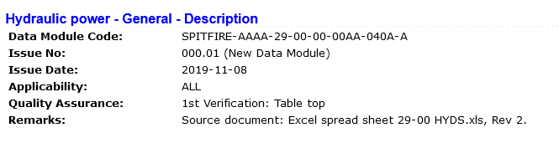
Data Module structure (cont’d)
The Identification and Status section provides information for:
Managing the Data Module within the Raytheon Eagle CSDB.
Managing Data Module applicability.
Managing the quality assurance process.
Controlling the retrieval processes.
Notes:
The identification and status section of the data module contains all the information needed to manage a data module and the data contained within it.
The identification section contains identification and address information. The identification portion is unique and includes the data module code, the language, and the issue date and the data module title.
The status segment contains such data as the security classification, the responsible partner company and originator, any applicability (effectivity), quality assurance status, data restrictions, and the reason for any update that was performed.
Together, the two sections make it possible to control a data module’s retrieval, to manage quality control and to provide applicability and other information to users.
The information within the identification and status section governs the whole data module, so its applicability, classification, and other requirements must always be appropriate for all of the data module content.
This shows how the IDSTATUS appears in the IETP.

Slide 9
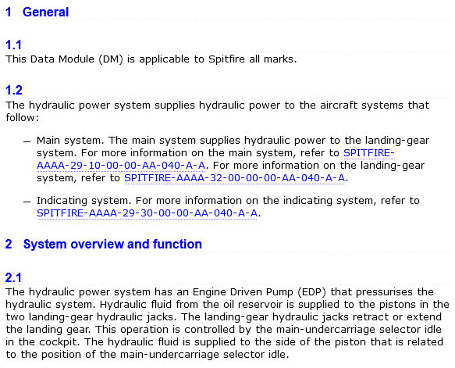
Data Module structure (cont’d)
The Contents section provides the user with the actual information required to conduct the task or describe the system.
Notes:
The Contents section of a data module contains the text and any links to the illustrations or multimedia objects that is presented to the user. The structure and elements of this segment of a data module are dictated by the type of data module selected and its schema.
The Contents section provides the user with the actual information required to conduct the task or describe the system. The BBMF maintenance documents use the following types:
Description
Procedural
Illustrated Parts Data

Slide 10
Data Module types
Some current S1000D Data Module types | Illustrated parts data Descriptive information Procedural information Container information Crew/operator information Fault information Maintenance checklists and inspections Maintenance planning information Process information Training information Wiring data information Wiring data description information
Notes:
S1000D has many different document types that have specific uses.
Programmes, such as the BBMF, uses only those document types necessary for the supported equipment, or platform.
The BBMF uses three document types:
Illustrated parts data or IPD;
Descriptive information; and
Procedural, or task, information

Slide 11
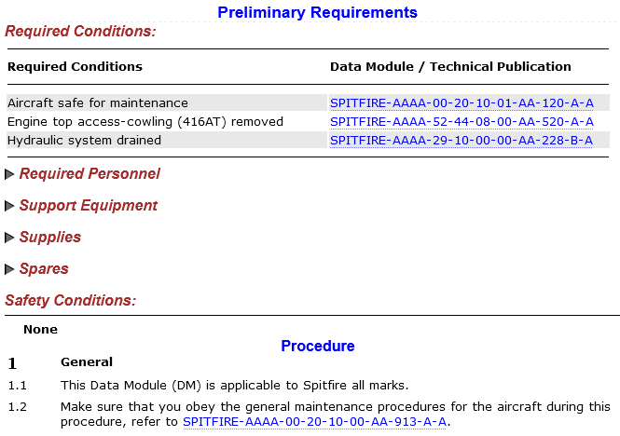
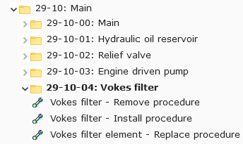

Procedural Information Type
SPITFIRE-AAAA-29-10-04-00AA-520A-A | Remove Procedure
SPITFIRE-AAAA-29-10-04-00AA-720A-A | Install Procedure
SPITFIRE-AAAA-29-10-04-01AA-920A-A | Remove and Install Procedure
Notes:
This shows the three main types of procedures used in the BBMF.
You can see the DMC, with the different information codes, and the corresponding DM title.
This shows how these procedural DM types appear in the Table of Contents of Chapter 29 of the Spitfire AMM.
The navigation can also show the DMC, instead of the title.
Here is an example of how a procedural Data Module appears in the LiveContent IETP.
A procedural Data Module consists of:
Information to check before the task….
Any associated spare parts or tools, and
Any relevant safety information about the task
This is followed by the numbered sequence of steps to carry out
NOTE: a link to another relevant data module will appear as a DMC. When you hover over you will see the title popup so you can check if this is relevant before you click it.

Slide 12
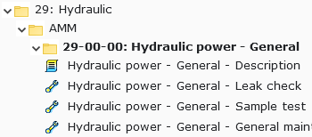
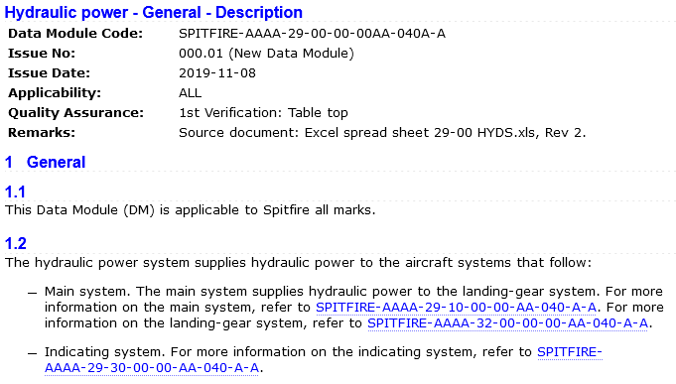
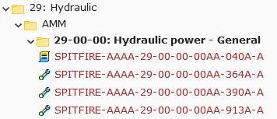
Description Information Type
SPITFIRE-AAAA-29-00-00-00AA-040A-A | General Description
Notes:
This shows the main type of descriptive Data Module used in the BBMF.
As with procedural you can see the DMC, with the information code, and the corresponding DM title.
This shows how this descriptive Data Module type appears in the Table of Contents of Chapter 29 of the Spitfire AMM.
This shows the navigation showing the DMC, instead of the title.
This shows the how a descriptive Data Module is displayed in the IETP.

Slide 13
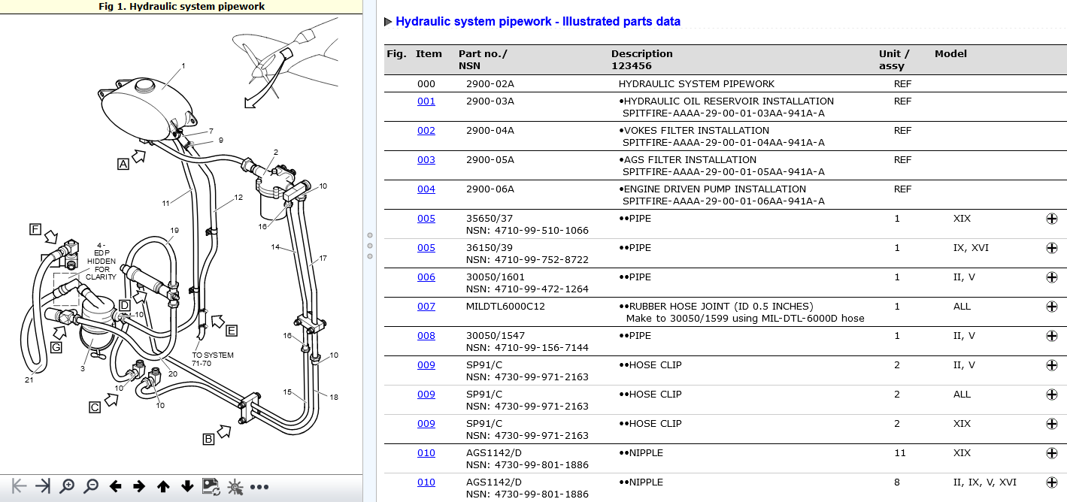
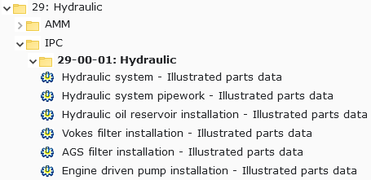
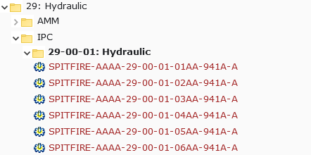
Illustrated Parts Information Type
SPITFIRE-AAAA-29-00-00-00AA-941A-A | Illustrated Parts Data
Notes:
This shows an Illustrated Parts Data Module Code.
As with procedural and descriptive you can see the DMC, with the information code, and the corresponding DM title.
This shows how Illustrated Parts Data Modules appear in the Table of Contents of Chapter 29 of the Spitfire IPC.
This shows the navigation showing the DMC, instead of the title.
This shows the how an Illustrated Parts Data Module is displayed in the IETP.
Each IPD will have one or more illustrations which will appear in the left-hand pane
IPD illustrations are hotspotted, that is, areas of the graphics are linked to areas in the text.
For example, for each numbered callout on the illustration there is a line item in the IPD table.
The numbered callouts are linked so they can be clicked to highlight the corresponding part information on the right.
The item number is also linked back to the graphic.
The IPD table has a shopping cart icon next to any orderable part. This will be discussed in the more detail in the LiveContent tutorial

Slide 14
The Publication Module
    What is a Publication Module?
    How is a Publication Module used?
    How will a Publication Module appear?

Slide 15
The Publication Module
A Publication Module defines an S1000D publication.
The PM acts like a table of contents to build the publication and IETP navigation.
The Publication Module defines the combined AMM and AIPC publication for each aircraft.
Notes:
A Publication Module is another S1000D document that is used at the programme level to define the publication.
As Data Modules as small, self-contained piece of information, the PM acts like a table of contents to link Data Modules into chapters and sub-chapters to build the publication and top-level navigation in the IETP.
The Publication Module is created by the BBMF S1000D authors sent to LiveContent as a definition of the combined AMM and AIPC publication for each aircraft.

Slide 16
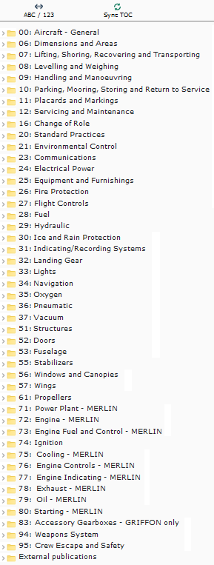
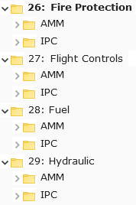
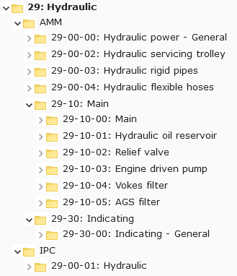
A publication structure
A BBMF publication is hierarchical.
The top level is the Chapter, or system.
Systems are divided into AMM and IPC.
AMM and IPC have further breakdown.
The breakdown is shown in the IETP.
Notes:
A BBMF publication is hierarchical.
The top level of hierarchy is the Chapter and represented by a two-digit number followed by the description of the aircraft system.
System are divided into AMM and IPC.
AMM and IPC have further breakdown.
The sub-chapters represent the system sub-system and assembly level breakdown of the aircraft and are represented as folder icons in the IETP

Slide 17
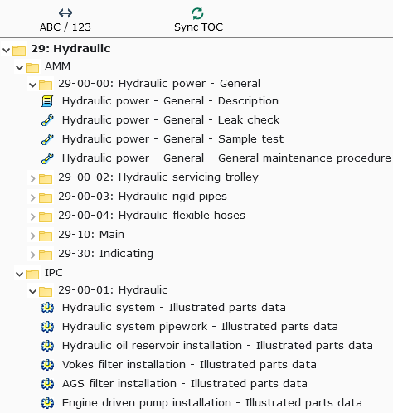
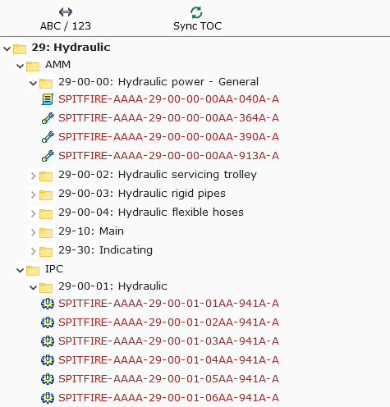



Data Modules in the BBMF Viewer
  Descriptive information
  Procedural information
  Illustrated parts data
Notes:
Inside the chapter breakdown you will see the tasks, description and spares parts breakdown generated from the Data Modules.
Each data module type has a different icon next to it
Each Data Module is represented by either its title or its DMC. You can choose which way to identify these by toggling the navigation

Slide 18
Simplified Technical English
    What is Simplified Technical English?
    How is Simplified Technical English used?
    How will Simplified Technical English appear?
Notes:
ASD-STE100 Simplified Technical English (STE) is a controlled language.
Developed in the early 1980s (as AECMA Simplified English) to help second-language speakers of English to unambiguously understand technical manuals written in English.
It was initially applicable only to commercial aviation. It then became a requirement for defence projects.
As a consequence, today, many maintenance manuals are written in STE.

Slide 19
Simplified Technical English (STE)
Reduce ambiguity
Improve the clarity of technical writing
Improve comprehension for people whose first language is not English
Make translation easier, faster and more cost effective
Improve clarity of maintenance activities with non native English speakers
Notes:
Simplified Technical English is claimed to:
Reduce ambiguity,Improve the clarity of technical writing, especially procedural writing, Improve comprehension for people whose first language is not English, Make human and machine translation easier, faster and more cost effective, Improve reliability concerns of maintenance activities by reducing their probability to introduce defects

Slide 20
Simplified Technical English (STE)
The Simplified Technical English specification consists of two parts:
    Writing Rules
    Dictionary

Slide 21
Simplified Technical English (STE)
Writing Rules:
  Restrict the length of noun clusters to no more than 3 words
  Restrict sentence length to no more than 20 words (procedural sentences) or 25 words (descriptive sentences)
  Restrict paragraphs to no more than 6 sentences (in descriptive text)
  Avoid slang and jargon while allowing for specific terminology
  Make instructions as specific as possible
Notes:
The Writing Rules differentiate between two types of topics: procedure and description. The Writing Rules also specify restrictions on grammar and style usage. For example, they require writers to:

Slide 22
Simplified Technical English (STE)
Writing Rules:
  Use articles such as a/an and the wherever possible
  Use simple verb tenses (past, present, and future)
  Use active voice
  Do not use present participles or gerunds (unless part of a Technical Name)
  Write sequential steps as separate sentences
  Start a safety instruction (a warning or a caution) with a clear and simple command or condition.
Notes:
The Writing Rules differentiate between two types of topics: procedure and description. The Writing Rules also specify restrictions on grammar and style usage. For example, they require writers to:

Slide 23
Simplified Technical English (STE): Dictionary
Keyword (Part of speech) | Approved meaning/ALTERNATIVES | APPROVED EXAMPLE | Not approved
Acceptance (n) | ACCEPT (v) | BEFORE YOU ACCEPT THE UNIT, YOU MUST DO THE SPECIFIED TEST PROCEDURE. | Before acceptance of unit, carry out the specified test procedure.
ACCESS (n) | The ability to go into or near. | GET ACCESS TO THE ACCUMULATOR FOR THE NO. 1 HYDRAULIC SYSTEM.
Accessible (adj) | ACCESS (n) | TURN THE COVER UNTIL YOU CAN GET ACCESS TO THE JACKS THAT HAVE “+” AND “-” MARKS. | Rotate the cover until the jacks marked + and - are accessible.
ACCIDENT (n) | An occurrence that causes injury or damage. | MAKE SURE THAT THE PINS ARE INSTALLED TO PREVENT ACCIDENTS.
Notes:
Here are some examples from a page of the ASD-STE100 Dictionary:
An explanation of the four columns:
Keyword (part of speech): This keyword has information on the type of word. Every permitted word in STE is only permitted as a specific word type. For example, “test” is only permitted as a noun (the test) but not as a verb (to test).
Approved meaning/ALTERNATIVES: This contains the definition of the permitted word. In the example table, ACCESS and ACCIDENT are allowed. Rephrasing or alternatives that are not permitted are listed in small letters (acceptance and accessible).
APPROVED EXAMPLE: When the text is written in capital letters, then it means that the entire text conforms to STE. If the keyword shown in column 1 is not permitted, then sample sentences in column 3 are provided with the alternatives listed in column 2.
Not approved: Small letters in this column indicate sentences that do not conform to STE. Column 4 will remain empty in the case of words that do conform to STE.
The dictionary includes entries of both approved and unapproved words. The approved words can only be used according to their specified meaning. For example, the word "close" can only be used in one of two meanings:
To move together, or to move to a position that stops or prevents materials from going in or out
To operate a circuit breaker to make an electrical circuit

Slide 24
An example that we sometime deviate from the writing rules:
  Safety a bolt to wire lock the bolt

Slide 25
A Summary of S1000D terms
Term | Meaning
DM | (Data Module)
PM | (Publication Module)
CSDB | (Common Source DataBase)
STE | (Simplified Technical English)
IETP | (Interactive Electronic Technical Publication)
ICN | (Illustration Control Number)

